Slide 1
Public Goods Under Financial Distress Pawel Janas
Olesya Kulish | bt716645 | Empirical Public Economics
Notes:
Look for tipin the text, exclude table 3

Slide 2
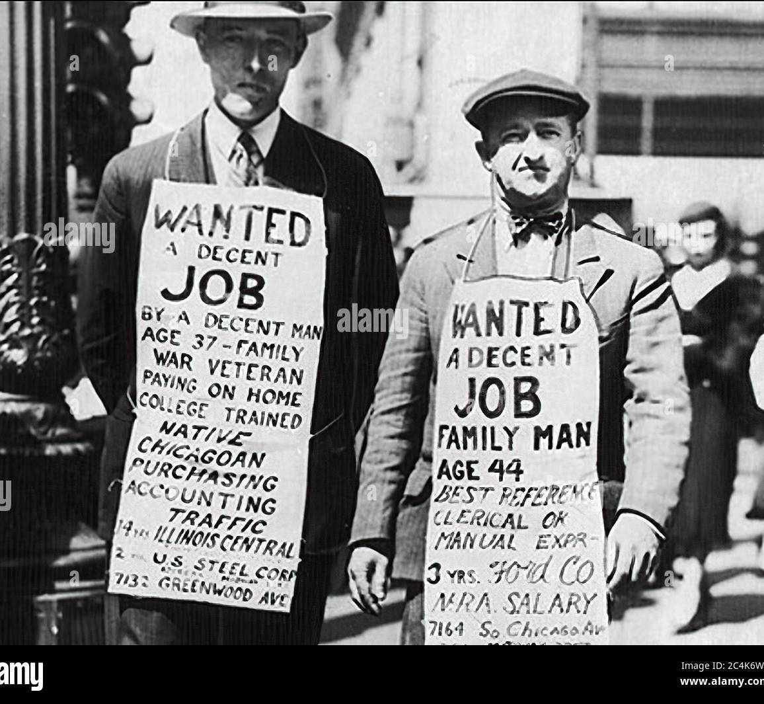
What is the Paper About?
Effects of public debt on municipal services and real outcomes during the Great Depression
Quasi experiment
Fiscal shocks without substantial intergovernmental or Federal Reserve support

Slide 3
My Task
Table 1: panels A and C
Table 2: columns 1,2,5
Table 3: panel A, columns 1, 4
Table 4: column 3

Slide 4
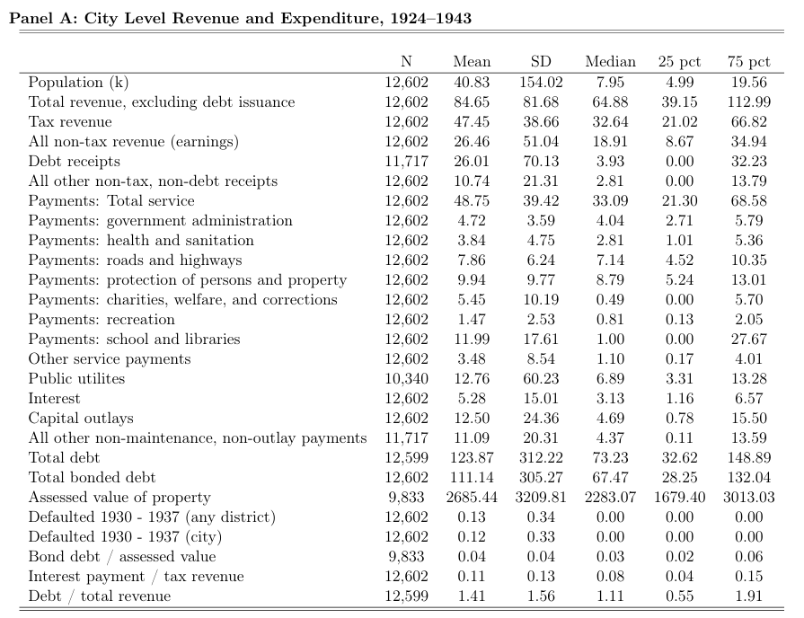
Table 1 Panel A: Original City Level Revenue and Expenditure 1924–1943

Slide 5
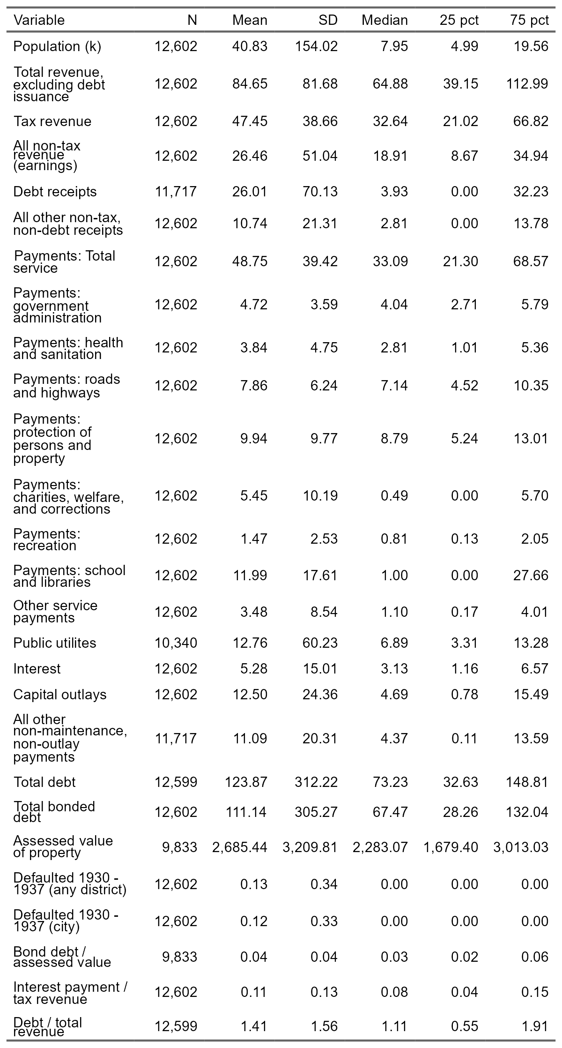
Table 1 Panel A: Replication City Level Revenue and Expenditure 1924–1943

Slide 6
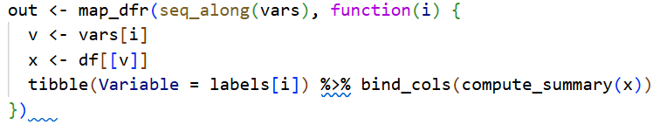
Table 1 Panel A: Replication
Define variables and labels
vars <- c() & labels <- c()
Match statistic
Compute summary statistics
compute_summary <- function(x)
Build summary table

Slide 7
Table 1 Panel A: Differences
Reason:
0.01 difference in the 75th percentile
different percentile calculation methods.
Added type = 2
 | 75 pct Original | 75 pct Replication
All other non-tax, non debt reciepts | 13,79 | 13,78
Payments: Total service | 68,58 | 68,57
Payments: School and libraries | 27,67 | 27,66
Capital outlays | 15,50 | 15,49
Total debt | 148,89 | 148,81

Slide 8

Table 1 Panel A: Replication

Slide 9
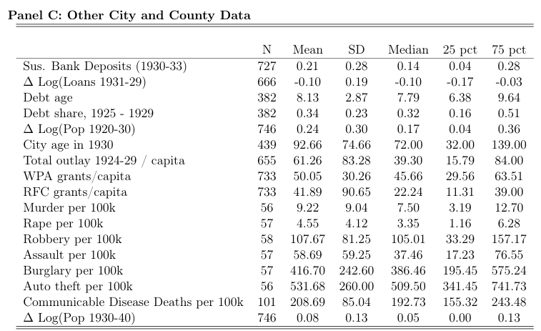
Table 1 Panel C: Original Other City and County Data

Slide 10
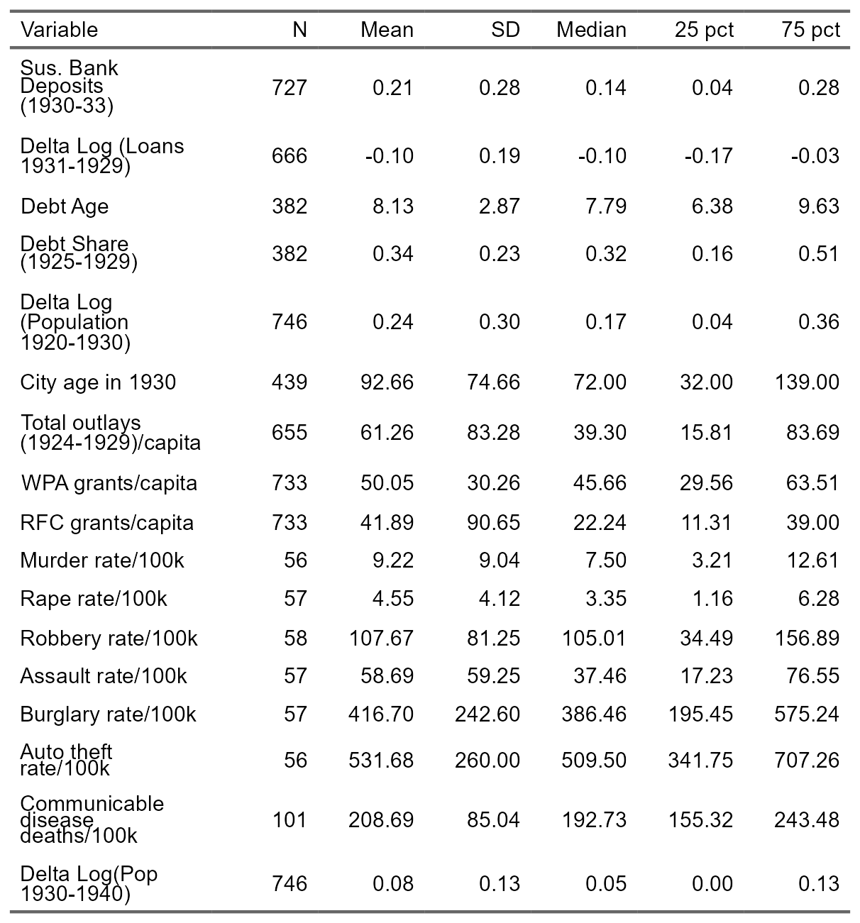
Table 1 Panel C: Replication Other City and County Data

Slide 11
Table 1 Panel C: Differences
 | 25 pct Original | 75 pct Original | 25 pct Replication | 75 pct Replication
Debt age |  | 9,64 |  | 9,63
Total outlay per capita 1924-29 | 15,79 | 84,00 | 15,81 | 83,69
Murder per 100k | 3,19 | 12,70 | 3,21 | 12,61
Robbery per 100k | 33,29 | 157,17 | 34,49 | 156,89
Auto theft per 100k | 341,45 | 741,73 | 341,75 | 707,26
Reason:
Same as in Panel A

Slide 12

Table 1 Panel C: Replication Other City and County Data

Slide 13
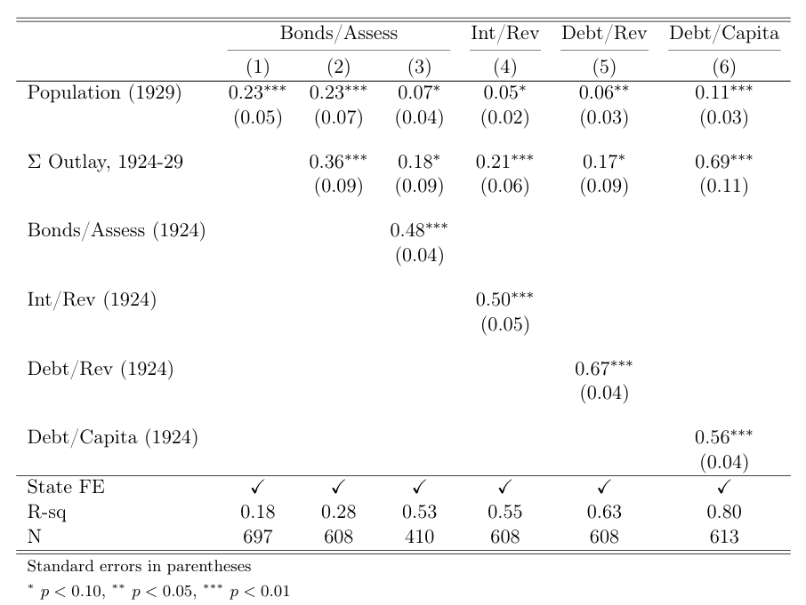
Table 2 Column 1, 2, 5: Original Determinants of pre-Depression financial leverage (1929) (1) State fixed effects and population (2) Same but adds Prior Capital Outlay (1924-1929) (5) Debt/Revenue ~ Population + Prior Debt (1924) + Prior Outlay
Notes:
State fixed effects and population explain 18% of the variation in leverage (2) Same but adds Prior Capital Outlay (1924-1929)
Controls for cities that already spent a lot on infrastructure
Tests if spending history explains leverage, or if population does
Column 5 — Debt/Revenue ~ Population + Prior Debt (1924) + Prior Outlay
Adds debt lag — cities that were already leveraged in 1924
Tests if past debt predicts 1929 debt (persistence)
Uses state fixed effects (accounts for state-level factors)

Slide 14
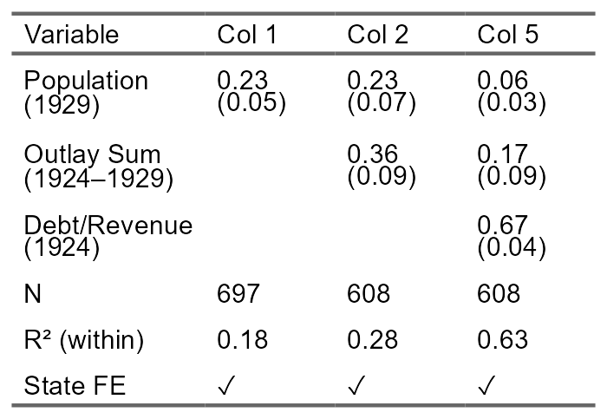
Table 2 Column 1, 2, 5: Replication Determinants of pre-Depression financial leverage (1929)

Slide 15
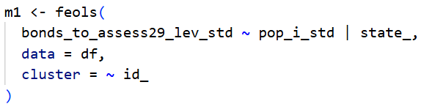
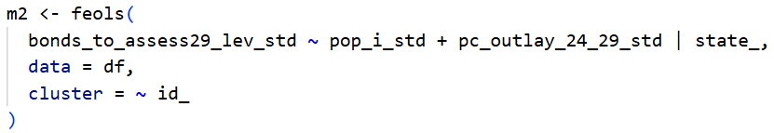
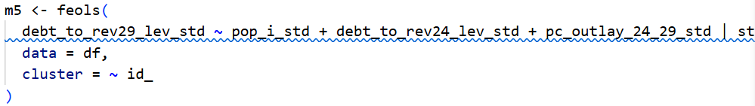
Table 2 Column 1, 2,5: Replication
Notes:
one-year snapshot analysis
m2 adds prior spending to see if it explains leverage better than population alone
m5 adds a lagged debt variable (debt from 1924) to show leverage is persistent — cities with high debt stay leveraged

Slide 16
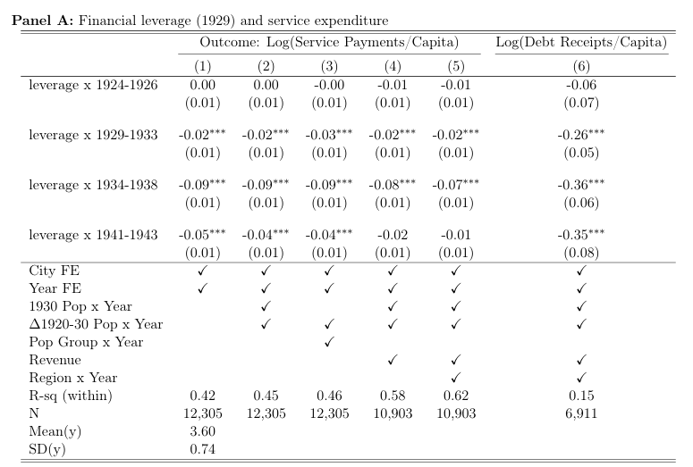
Table 3 Panel A Column 1, 4: Original Leverage and local public expenditure
Notes:
tests whether bond-financed debt (1929) affected maintenance & depreciation spending
It's a difference-in-differences design
Column 1: Basic DiD — only City FE + Year FE-
Column 4: Full spec — adds population controls (1930 pop, 1920–30 pop growth), revenue controls (lagged revenue), and interacts them with year FE

Slide 17
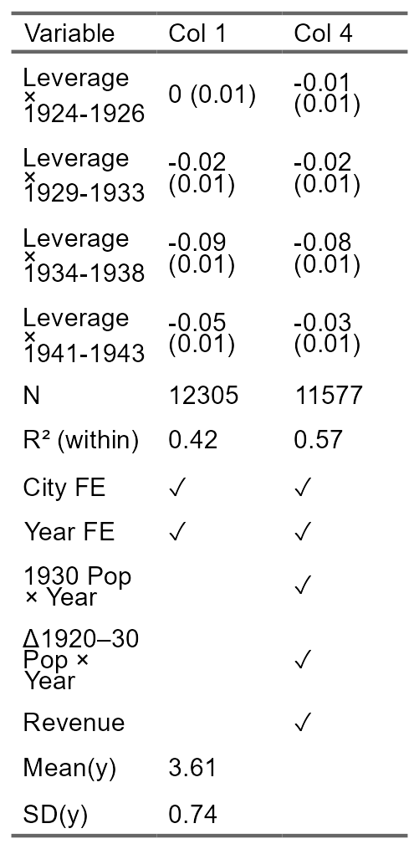
Table 3 Panel A Column 1, 4: Replication Leverage and local public expenditure

Slide 18
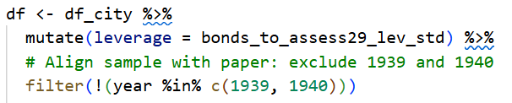
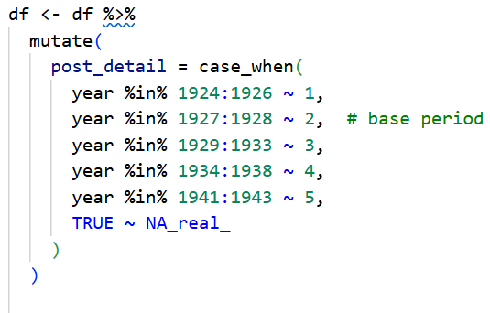
Table 3 Panel A Column 1, 4: Replication
Notes:
Treatment variable setup
Period Indicators for DiD (time variation)

Slide 19
Table 3 Panel A Column 1, 4: Differences
 | Original | Replication
Mean | 3,60 | 3,61
N (4) | 10903 | 11577
R-sq (4) | 0,58 | 0,57
Leverage x 1941-43 (4) | -0,02 | -0,03
Possible Reasons:
Interaction term handling (year × population)
Lagged variable construction differences
Sample restrictions not matched (xtreg implicit rules)
Reference year treatment (period 2 + year 1928)
Clustering/SE differences due to N

Slide 20
Table 3 Panel A Column 1, 4: Differences
 | Original | Replication
Mean | 3,60 | 3,61
N (4) | 10903 | 11577
R-sq (4) | 0,58 | 0,57
Leverage x 1941-43 (4) | -0,02 | -0,03
Fixes implemented:
Excluded 1939-1940 ✓
Matched period indicators ✓
Created lagged revenue ✓
Matched model specification ✓
Explicit missing data filtering ✓
Added diagnostics ✓
Attempted xtreg restrictions ✓
Notes:
Replication is difficult even with published code
Sample construction drives most differences
R fixest vs Stata xtreg have subtle algorithmic differences
matched specifications as closely as possible

Slide 21
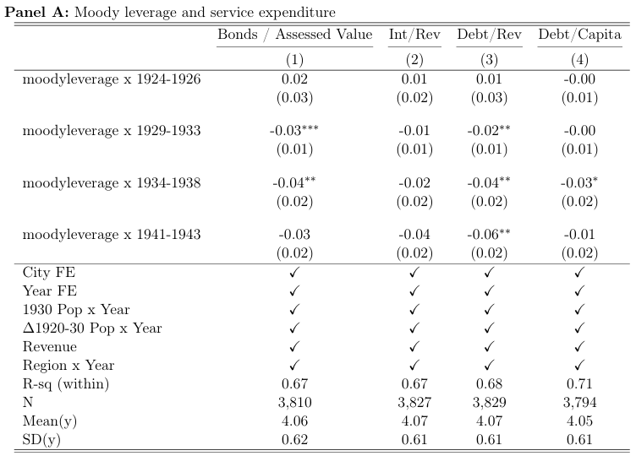
Table 4 Column 3: Original Moody-leverage and service expenditure
Notes:
FE-OLS on Maintenance Spending
How much does leverage causally reduce maintenance spending?

Slide 22
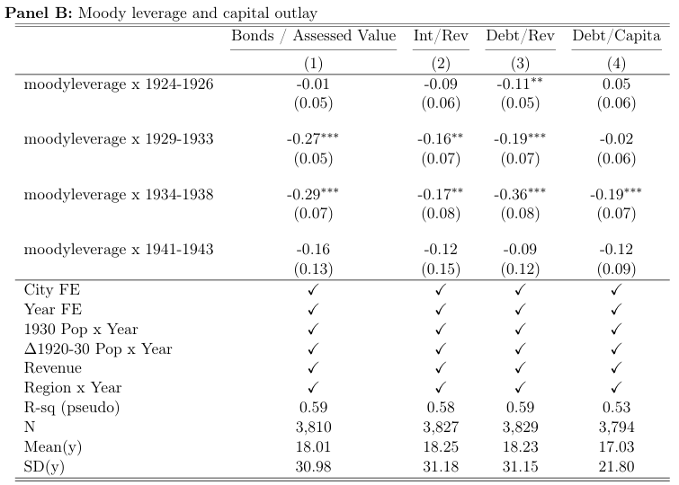
Table 4 Column 3: Original Moody-leverage and capital outlay
Notes:
Poisson Pseudo Maximum Likelihood on Capital Outlay
How does leverage affect the NUMBER of capital projects?

Slide 23
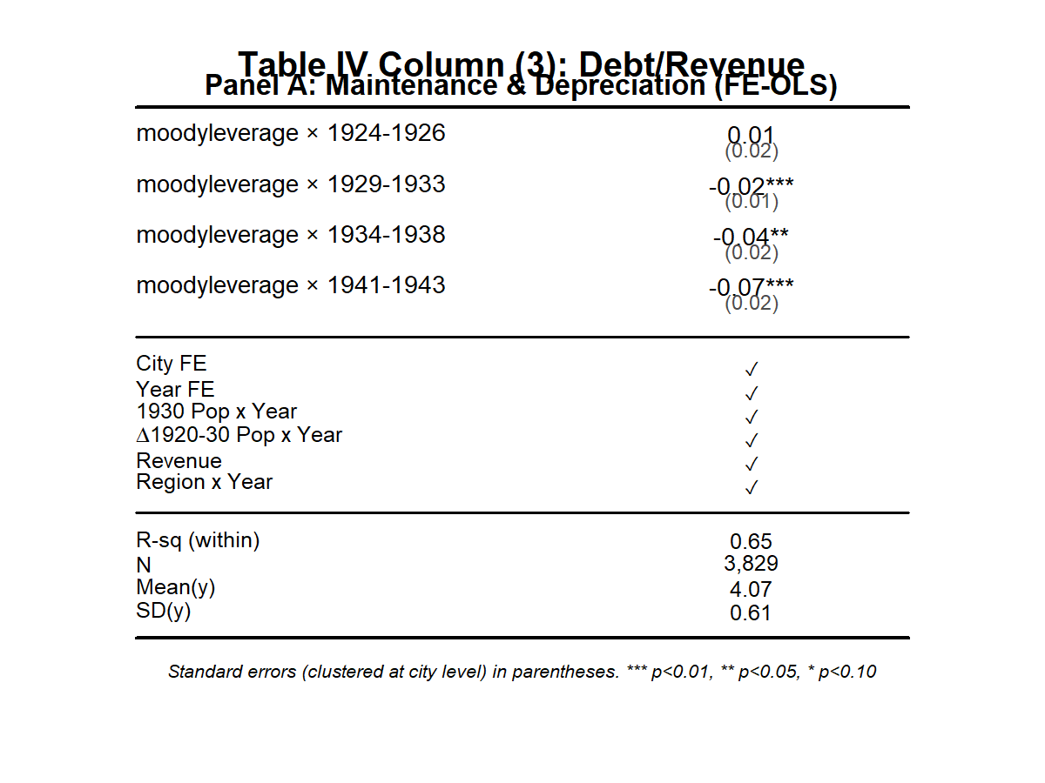
Table 4 Column 3: Replication Moody-leverage and service expenditure

Slide 24
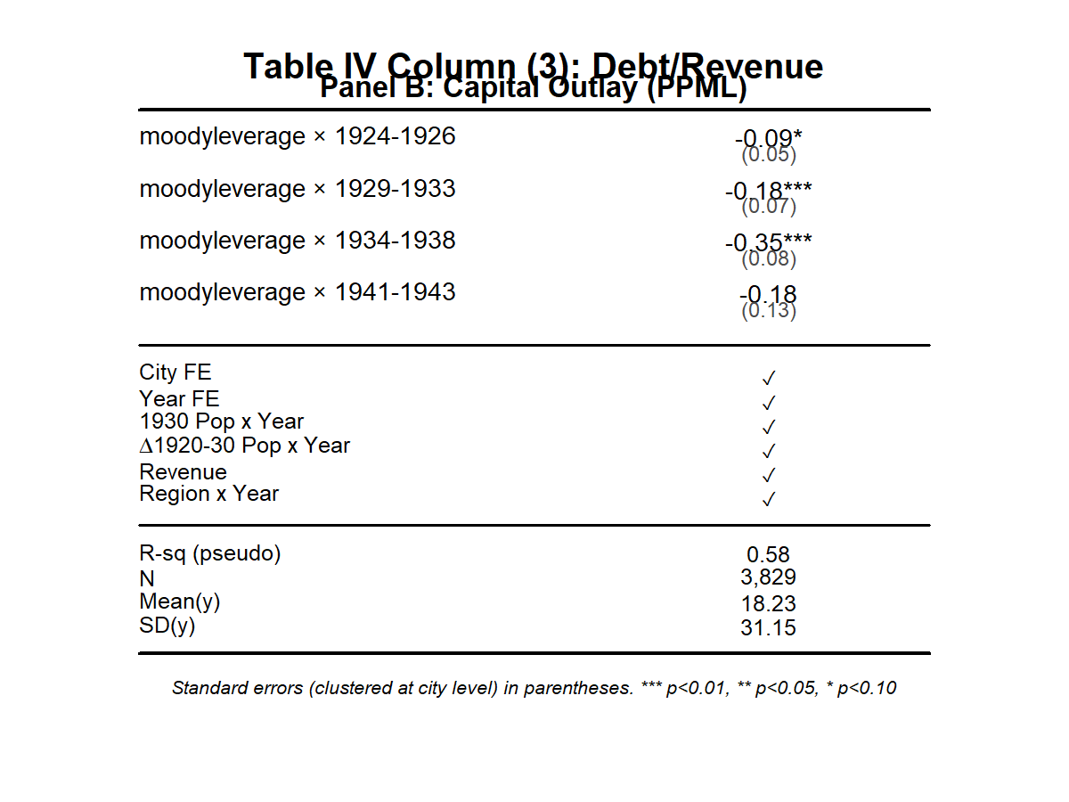
Table 4 Column 3: Replication Moody-leverage and capital outlay

Slide 25
Table 4 Panel A Column 3: Differences
Panel A | Original | Replication
SE Moody leverage 1924-26 | 0,03 | 0,02
R-sq | 0,68 | 0,65
Moody leverage 1941-43 | -0,06 | -0.07
Possible Reason:
Clustering/degrees of freedom: diffrent cluster counts can affect R
Possible Reason:
Lag construction breaks around the 1939-1940 gap → 1941-43 coefficient doubles
Data excludes 1939-1940, creating a gap
Minor issues: Interaction terms and PPML algorithms differ slightly between R and Stata
Panel B | Original | Replication
Moody leverage 1924-26 | -0,11 | -0,09
Moody leverage 1929-33 | -0,19 | -0,18
Moody leverage 1934-38 | -0,36 | -0,35
Moody leverage 1941-43 | -0,09 | -0,18
SE Moody leverage 1941-43 | 0,12 | 0,13
R-sq | 0,59 | 0,58

Slide 26
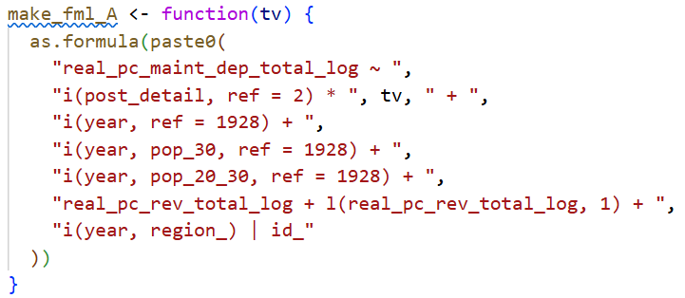
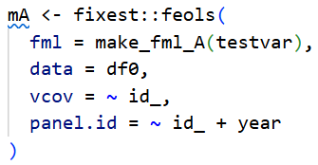
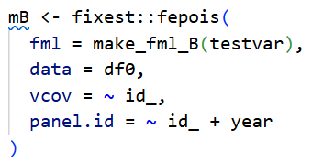
Table 4 Panel A Column 3: Code
DiD Formula
OLS VS Poisson
Notes:
Compare high-leverage vs low-leverage cities across time periods while controlling for confounds
continuous spending = OLS, count data = Poisson

Slide 27
Additional Analysis: Historical Comparison 1920-21 VS 1929-1938
Compare spending
Recession 1920-21 after WW1 (no government intervention)
The Great Depression (government intervention)
Did federal intervention(RFC/WPA) matter?
Data already available
Create two separate DiD models to estimate
Comparison of coefficients

Slide 28
Discussion

